Slide 1
Matrix Transforms
Moving Objects in Space
Programming – Math for Games

Slide 2
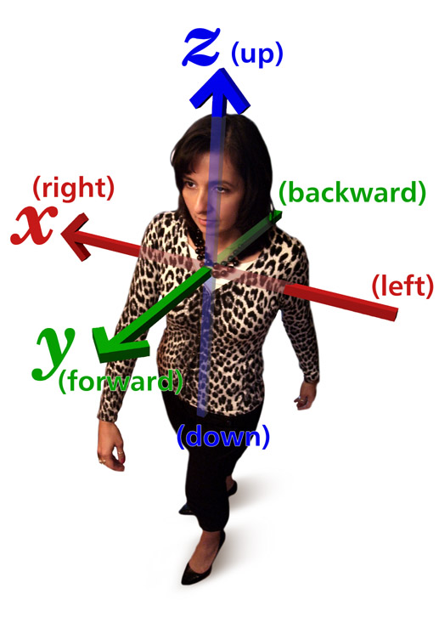
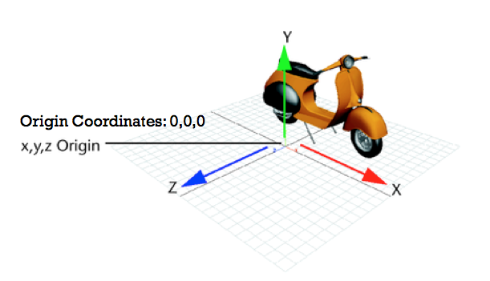
Contents
Matrices
Matrix Transforms
Scale Matrices
Scaling Points and Vectors
Rotation Matrices
Rotating Points and Vectors
Homogeneous Transforms
The W element
Translation Matrices
Inverse

Slide 3

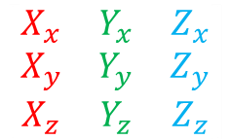
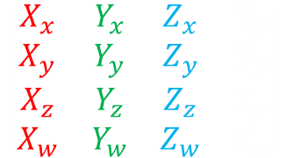

Matrices
Referring back to a previous session, Matrices are arrays of numbers that store 2-D and 3-D Vectors
Vectors are also matrices
Matrices are arranged in axis
We can multiply Matrices together to combine them
But what actually is the “result”?
In games, Matrices represent Transforms
But what are Transforms?
$$\left[\begin{matrix}X_{x} & Y_{x} \\ X_{y} & Y_{y}\end{matrix}\right]$$
$$\left[\begin{matrix}X \\ Y \\ Z\end{matrix}\right]$$
$$\left[\begin{matrix}X_{x} & Y_{x} & Z_{x} \\ X_{y} & Y_{y} & Z_{y} \\ X_{z} & Y_{z} & Z_{z}\end{matrix}\right]$$
$$\left[\begin{matrix}X_{x} & Y_{x} & Z_{x} & T_{x} \\ X_{y} & Y_{y} & Z_{y} & T_{y} \\ X_{z} & Y_{z} & Z_{z} & T_{z} \\ X_{w} & Y_{w} & Z_{w} & T_{w}\end{matrix}\right]$$

Slide 4
Transform Matrices
Matrices are used to store the scale, rotation and position of every object in the game world.
These are called Homogenous Transform Matrices (or just “transform”).
Matrices are more efficient to process in 3-D than storing separate scales, rotations and positions.
E.g.
Rotating in 3D with a matrix: 28 operations.
Rotating in 3D without a matrix (Quaternions): 39 operations!

Slide 5
Transform Matrices
There are different types of Matrices used in games:
Rotation Matrices just store a rotation
Can be used to rotate other matrices or vectors
Scale Matrices store a scale
Can scale other matrices or vectors
Translation Matrices stores a position or offset
Can move another matrix or point
Homogenous Transform Matrices combine all of these together.
Stores scale, rotation and position combined
Can be used to transform one object or vector by another object

Slide 6
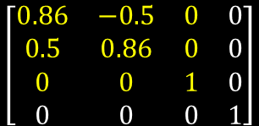

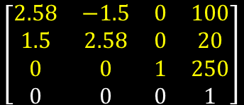

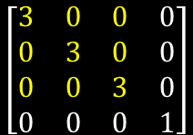
Transform Matrices - Examples
Rotation Matrix
$$\left[\begin{matrix}0.86 & −0.5 & 0 & 0 \\ 0.5 & 0.86 & 0 & 0 \\ 0 & 0 & 1 & 0 \\ 0 & 0 & 0 & 1\end{matrix}\right]$$
Homogenous Transform Matrix
Identity matrix
Scale Matrix
$$\left[\begin{matrix}1 & 0 & 0 & 0 \\ 0 & 1 & 0 & 0 \\ 0 & 0 & 1 & 0 \\ 0 & 0 & 0 & 1\end{matrix}\right]$$
$$\left[\begin{matrix}3 & 0 & 0 & 0 \\ 0 & 3 & 0 & 0 \\ 0 & 0 & 3 & 0 \\ 0 & 0 & 0 & 1\end{matrix}\right]$$
$$\left[\begin{matrix}2.58 & −1.5 & 0 & 100 \\ 1.5 & 2.58 & 0 & 20 \\ 0 & 0 & 1 & 250 \\ 0 & 0 & 0 & 1\end{matrix}\right]$$
All matrices start as identity
Made from a combination of Rotation, Scale, and Translation
Translation Matrix
$$\left[\begin{matrix}1 & 0 & 0 & 100 \\ 0 & 1 & 0 & 20 \\ 0 & 0 & 1 & 250 \\ 0 & 0 & 0 & 1\end{matrix}\right]$$

Slide 7
Homogenous Transform Matrices
A transform is made up of four things:
The X axis (often the Right direction)
The Y axis (often the Up direction)
The Z axis (often the Forward direction)
The position
These combined tell us everything we need to know about the objects rotation, scale and position.

Slide 8


Transforms in 2-D: Positions
Position is stored very simply:
X Position
$$\left[\begin{matrix}1 & 0 & T_{x} \\ 0 & 1 & T_{y} \\ 0 & 0 & 1\end{matrix}\right]$$
Y Position
$$\left[\begin{matrix}1 & 0 & T_{x} \\ 0 & 1 & T_{y} \\ 0 & 0 & 1\end{matrix}\right]$$
The diagonals are 1s because all matrices are built on top of an identity matrix

Slide 9
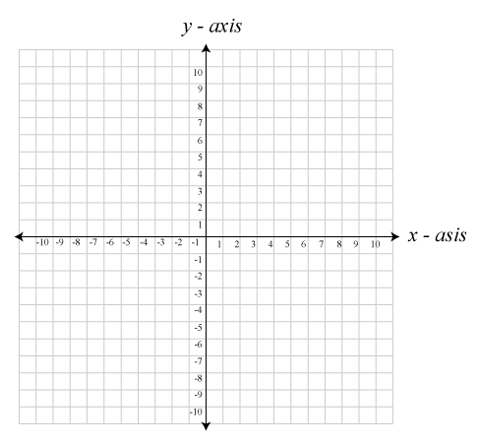


Transforms in 2-D: Position Examples
$$\left[\begin{matrix}1 & 0 & 3 \\ 0 & 1 & 5 \\ 0 & 0 & 1\end{matrix}\right]$$
$$\left[\begin{matrix}1 & 0 & −8 \\ 0 & 1 & −3 \\ 0 & 0 & 1\end{matrix}\right]$$

Slide 10
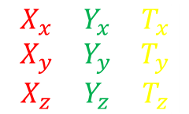
Transforms in 2-D: Facing Vectors
The rest of the matrix is made from vectors that store an axis, often used to represent the object’s facing directions:
$$\left[\begin{matrix}X_{x} & Y_{x} & T_{x} \\ X_{y} & Y_{y} & T_{y} \\ X_{z} & Y_{z} & T_{z}\end{matrix}\right]$$
Up Facing
Right Facing

Slide 11
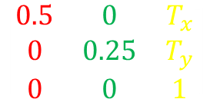
Transforms in 2-D: Facing Vectors
1
0.5
$$\left[\begin{matrix}0.5 & 0 & T_{x} \\ 0 & 0.25 & T_{y} \\ 0 & 0 & 1\end{matrix}\right]$$
-1
-0.5
0
0.5
1
-0.5
-1

Slide 12
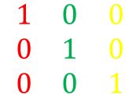
Transforms in 2-D: Identity
The Identity Matrix represents a transform with:
A position of (0, 0)
An X axis of (1, 0)
A Y axis of (0, 1)
1
0.5
$$\left[\begin{matrix}1 & 0 & 0 \\ 0 & 1 & 0 \\ 0 & 0 & 1\end{matrix}\right]$$
-1
-0.5
0
0.5
1
-0.5
-1

Slide 13

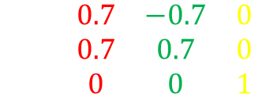
Transforms in 2-D: Rotation
Rotation matrices represent a matrix with its axes rotated around the Origin
In this example, Matrix A is rotated $\frac{π}{4}$ counter-clockwise
A = $\left[\begin{matrix}0.7 & −0.7 & 0 \\ 0.7 & 0.7 & 0 \\ 0 & 0 & 1\end{matrix}\right]$

Slide 14






Transforms in 2-D: Rotation
It can be multiplied against a Point or Vector to rotate the Point / Vector around the Origin
$$P^{1}$$
$$P$$
$$V$$
$$V^{1}$$
$$V^{1}=AV$$
$$P^{1}=AP$$

Slide 15




Transforms in 2-D: Rotation
To build a rotation matrix we need to look back at Trigonometry and the Sine and Cosine functions
You may recall that we can use these functions to plot a Unit Vector around a Unit Circle
$$X=cos(a)$$
$$X=cos\left(\frac{π}{4}\right)=0.7$$
$$Y=sin⁡(a)$$
$$Y=sin\left(\frac{π}{4}\right)=0.7$$

Slide 16








Transforms in 2-D: Rotation
$$X=cos\left(0\right)=1$$
$$X=cos\left(π\right)=−1$$
$$Y=sin\left(0\right)=0$$
$$Y=sin\left(π\right)=0$$
$$X=cos\left(−\frac{π}{4}\right)=0.7$$
$$X=cos\left(\frac{π}{2}\right)=0$$
$$Y=sin\left(−\frac{π}{4}\right)=−0.7$$
$$Y=sin\left(\frac{π}{2}\right)=1$$

Slide 17

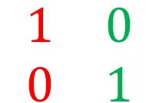




Transforms in 2-D: Rotation
To build a Matrix to perform a rotation, we need to populate each element of the matrix
Rather than a single Vector being rotated as on the previous slides, we need to rotate all axes of the Matrix
The Identity Matrix represents an un-rotated Matrix using an angle of 0 radians
Using sine and cosine we can build an Identity Matrix as the diagrams show
Now if we increase the rotation from 0 to say, $\frac{π}{2}$, what would happen?
$$\left[\begin{matrix}1 & 0 \\ 0 & 1\end{matrix}\right]$$
$$X_{x}=cos\left(0\right)=1$$
$$Y_{x}=sin\left(0\right)=0$$
$$X_{y}=sin\left(0\right)=0$$
$$Y_{y}=cos⁡(0)=1$$

Slide 18






Transforms in 2-D: Rotation
Using the sine / cosine combination on the previous slide is not enough!
Let’s rotate $\frac{π}{2}$ in a counter-clockwise direction….
Stop right there!
The X-axis rotated counter-clockwise, but the Y-axis went clockwise!
$$\left[\begin{matrix}0 & 1 \\ 1 & 0\end{matrix}\right]$$
$$X_{x}=cos\left(\frac{π}{2}\right)=0$$
$$Y_{x}=sin\left(\frac{π}{2}\right)=1$$
$$X_{y}=sin\left(\frac{π}{2}\right)=1$$
$$Y_{y}=cos⁡(\frac{π}{2})=0$$

Slide 19





Transforms in 2-D: Rotation
We can remedy this by simply negating the X element of the Y-axis
This gives us the following standard Matrix for creating a rotation, specified on the next slide…
$$\left[\begin{matrix}0 & −1 \\ 1 & 0\end{matrix}\right]$$
$$X_{x}=cos\left(\frac{π}{2}\right)=0$$
$$Y_{x}=−sin\left(\frac{π}{2}\right)=−1$$
$$X_{y}=sin\left(\frac{π}{2}\right)=1$$
$$Y_{y}=cos⁡(\frac{π}{2})=0$$

Slide 20

Transforms in 2-D: Rotation
For any angle a…
$$\left[\begin{matrix}\cos\left(a\right) & −\sin\left(a\right) & 0 \\ \sin\left(a\right) & \cos\left(a\right) & 0 \\ 0 & 0 & 1\end{matrix}\right]$$

Slide 21
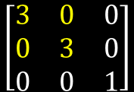
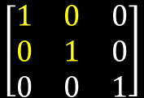
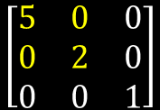
Transforms in 2-D: Scale
Scale is stored in the magnitude of the facing vectors
This means it occupies the same elements as rotation.
$$\left[\begin{matrix}1 & 0 & 0 \\ 0 & 1 & 0 \\ 0 & 0 & 1\end{matrix}\right]$$
$$\left[\begin{matrix}3 & 0 & 0 \\ 0 & 3 & 0 \\ 0 & 0 & 1\end{matrix}\right]$$
$$\left[\begin{matrix}5 & 0 & 0 \\ 0 & 2 & 0 \\ 0 & 0 & 1\end{matrix}\right]$$
Identity Matrix
Has a scale of 1 on both X and Y
Scale of 3 on both X and Y
Scaled 5 on the X and 2 on the Y

Slide 22

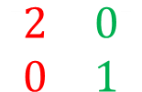
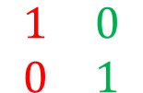
Transforms in 2-D: Scale
When scaling an object, we just modify these magnitudes
Want something to be wider? Scale its X axis
Want it to be taller? Scale its Y axis
Want something flipped? Negate an axis
It does not matter if the matrix is also rotated, we simply scale the axis
$$\left[\begin{matrix}1 & 0 \\ 0 & 1\end{matrix}\right]$$
$$\left[\begin{matrix}2 & 0 \\ 0 & 1\end{matrix}\right]$$

Slide 23

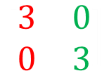
Transforms in 2-D: Scale
We can use a Scale matrix to bring a Point closer to the Origin, or move it further away
It can shrink or extend a Vector
$$\left[\begin{matrix}−0.25 & 0 \\ 0 & −0.25\end{matrix}\right]$$
$$\left[\begin{matrix}3 & 0 \\ 0 & 3\end{matrix}\right]$$

Slide 24
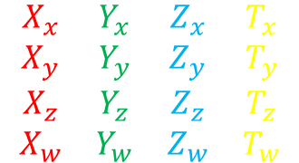
Transforms in 3-D
So far we have been discussing 2-D Matrices, but the same applies for 3-D Matrices
Just add in an extra axis
$$\left[\begin{matrix}X_{x} & Y_{x} & Z_{x} & T_{x} \\ X_{y} & Y_{y} & Z_{y} & T_{y} \\ X_{z} & Y_{z} & Z_{z} & T_{z} \\ X_{w} & Y_{w} & Z_{w} & T_{w}\end{matrix}\right]$$
Right
Up
Forward
Position

Slide 25


Transforms in 3-D: Position
Now with a Z component
X Position
$$\left[\begin{matrix}1 & 0 & 0 & 120 \\ 0 & 1 & 0 & 30 \\ 0 & 0 & 1 & 250 \\ 0 & 0 & 0 & 1\end{matrix}\right]$$
$$\left[\begin{matrix}1 & 0 & 0 & T_{x} \\ 0 & 1 & 0 & T_{y} \\ 0 & 0 & 1 & T_{z} \\ 0 & 0 & 0 & 1\end{matrix}\right]$$
Y Position
Z Position
A Translation Matrix with a position of (120, 30, 250)

Slide 26
Transforms in 3-D: Rotation
Rotating in 3-D uses the same approach to 2D
In 2-D we are simply rotating around an imaginary Z-axis that points towards the user
In 3-D we use the same sine / cosine combination
We rotate around a chosen axis, leaving the one we are rotating around as a Unit Vector in that axis and modifying the other axes

Slide 27
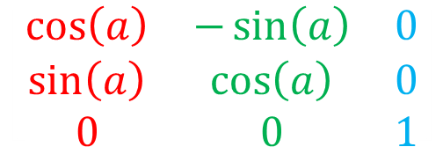
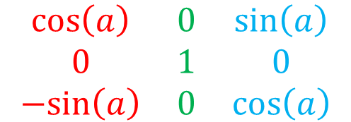
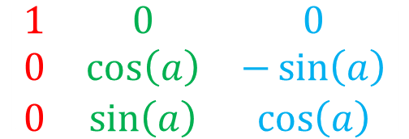
Transforms in 3-D: Rotation
$$\left[\begin{matrix}1 & 0 & 0 \\ 0 & \cos\left(a\right) & −\sin\left(a\right) \\ 0 & \sin\left(a\right) & \cos\left(a\right)\end{matrix}\right]$$
Rotate around the X-axis
X doesn’t change
Rotate around the Y-axis
Y doesn’t change
Rotate around the Z-axis
Z doesn’t change
$$\left[\begin{matrix}\cos\left(a\right) & 0 & \sin\left(a\right) \\ 0 & 1 & 0 \\ −sin\left(a\right) & 0 & \cos\left(a\right)\end{matrix}\right]$$
$$\left[\begin{matrix}\cos\left(a\right) & −\sin\left(a\right) & 0 \\ \sin\left(a\right) & \cos\left(a\right) & 0 \\ 0 & 0 & 1\end{matrix}\right]$$

Slide 28
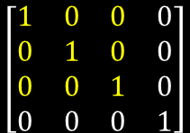
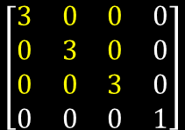
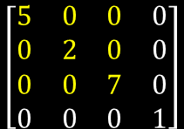
Transforms in 3-D: Scale
Scale is stored just as it is in 2-D
Just add in a Z component
$$\left[\begin{matrix}1 & 0 & 0 & 0 \\ 0 & 1 & 0 & 0 \\ 0 & 0 & 1 & 0 \\ 0 & 0 & 0 & 1\end{matrix}\right]$$
$$\left[\begin{matrix}3 & 0 & 0 & 0 \\ 0 & 3 & 0 & 0 \\ 0 & 0 & 3 & 0 \\ 0 & 0 & 0 & 1\end{matrix}\right]$$
$$\left[\begin{matrix}5 & 0 & 0 & 0 \\ 0 & 2 & 0 & 0 \\ 0 & 0 & 7 & 0 \\ 0 & 0 & 0 & 1\end{matrix}\right]$$
Identity Matrix
Has a scale of 1 X, Y and Z
Scale of 3 in X, Y, and Z
Scaled 5 on the X, 2 on the Y, and 7 on the Z

Slide 29

The W Element
$$\left[\begin{matrix}2.58 & −1.5 & 0 & 100 \\ 1.5 & 2.58 & 0 & 20 \\ 0 & 0 & 1 & 250 \\ 0 & 0 & 0 & 1\end{matrix}\right]$$
Why is this row here?
You might have noticed all our axes have this extra W component
Without it, we would have a 3x4 matrix which can’t multiply with a 3x1 vector!
A Matrix’s column count doesn’t match a Vector’s row count!
Enter Homogeneous Coordinates…

Slide 30

Homogeneous Coordinates
Homogeneous Coordinates is a term given to a complex system of coordinates primarily used in projection
They also have frequent use in Computer Graphics and applications with visual representations, such as games
What they allow us to do is incorporate Rotation, Scale and Translation within a Matrix
To implement them we need to add an additional element to our Vectors, the $W$ element

Slide 31



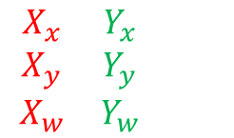
The W Element
We simply add the additional element to the end of our Vectors and Matrices
This turns our 2-D Vectors into 3x1, 3-D Vectors into 4x1, and Matrices also enlarge
But what do we put in this new element?
$$\left[\begin{matrix}X \\ Y \\ Z \\ W\end{matrix}\right]$$
$$\left[\begin{matrix}X_{x} & Y_{x} & Z_{x} & T_{x} \\ X_{y} & Y_{y} & Z_{y} & T_{y} \\ X_{z} & Y_{z} & Z_{z} & T_{z} \\ X_{w} & Y_{w} & Z_{w} & T_{w}\end{matrix}\right]$$
$$\left[\begin{matrix}X \\ Y \\ W\end{matrix}\right]$$
$$\left[\begin{matrix}X_{x} & Y_{x} & T_{x} \\ X_{y} & Y_{y} & T_{y} \\ X_{w} & Y_{w} & T_{w}\end{matrix}\right]$$
2-D
3-D

Slide 32


The W Element
For a Vector, we use W to represent whether it’s a Point or a Vector
A Point will usually have a W starting at 1
A Vector will usually have a W starting at 0
The W is not always 1 or 0
Certain maths will modify it
$$P=\left[\begin{matrix}X \\ Y \\ Z \\ 1\end{matrix}\right]$$
$$V=\left[\begin{matrix}X \\ Y \\ Z \\ 0\end{matrix}\right]$$

Slide 33

The W Element
A very generic simplification of it could be…
The W element specifies what percentage of the Translation axis of a Matrix will be added to the Point or Vector when they are multiplied
The X, Y and Z axis in a Matrix are all Vectors
W of 0
The Translation axis in this case would be thought of as a Point
W of 1
$$\left[\begin{matrix}X_{x} & Y_{x} & Z_{x} & T_{x} \\ X_{y} & Y_{y} & Z_{y} & T_{y} \\ X_{z} & Y_{z} & Z_{z} & T_{z} \\ 0 & 0 & 0 & 1\end{matrix}\right]$$

Slide 34




Translation Matrices and Vectors
With a W of 0, the vector is scaled but 0% of the translation axis is added.
$$\left[\begin{matrix}0.5 & 0 & 0 & 2 \\ 0 & 1 & 0 & 2 \\ 0 & 0 & 2 & 2 \\ 0 & 0 & 0 & 1\end{matrix}\right]\left[\begin{matrix}6 \\ 0 \\ 2 \\ 0\end{matrix}\right]=\left[\begin{matrix}3 \\ ? \\ ? \\ ?\end{matrix}\right]$$
$$\left[\begin{matrix}0.5 & 0 & 0 & 2 \\ 0 & 1 & 0 & 2 \\ 0 & 0 & 2 & 2 \\ 0 & 0 & 0 & 1\end{matrix}\right]\left[\begin{matrix}6 \\ 0 \\ 2 \\ 0\end{matrix}\right]=\left[\begin{matrix}3 \\ 0 \\ ? \\ ?\end{matrix}\right]$$
$$0.5×6+0×0+0×2+2×0=3$$
$$0×6+1×0+0×2+2×0=0$$
$$\left[\begin{matrix}0.5 & 0 & 0 & 2 \\ 0 & 1 & 0 & 2 \\ 0 & 0 & 2 & 2 \\ 0 & 0 & 0 & 1\end{matrix}\right]\left[\begin{matrix}6 \\ 0 \\ 2 \\ 0\end{matrix}\right]=\left[\begin{matrix}3 \\ 0 \\ 4 \\ ?\end{matrix}\right]$$
$$\left[\begin{matrix}0.5 & 0 & 0 & 2 \\ 0 & 1 & 0 & 2 \\ 0 & 0 & 2 & 2 \\ 0 & 0 & 0 & 1\end{matrix}\right]\left[\begin{matrix}6 \\ 0 \\ 2 \\ 0\end{matrix}\right]=\left[\begin{matrix}3 \\ 0 \\ 4 \\ 0\end{matrix}\right]$$
$$0×6+0×0+2×2+2×0=4$$
$$0×6+0×0+0×2+1×0=1$$

Slide 35






Translation Matrices and Points
With a W of 1, the vector is scaled and 100% of the translation axis is added!
$$\left[\begin{matrix}0.5 & 0 & 0 & 2 \\ 0 & 1 & 0 & 2 \\ 0 & 0 & 2 & 2 \\ 0 & 0 & 0 & 1\end{matrix}\right]\left[\begin{matrix}6 \\ 0 \\ 2 \\ 1\end{matrix}\right]=\left[\begin{matrix}5 \\ ? \\ ? \\ ?\end{matrix}\right]$$
$$\left[\begin{matrix}0.5 & 0 & 0 & 2 \\ 0 & 1 & 0 & 2 \\ 0 & 0 & 2 & 2 \\ 0 & 0 & 0 & 1\end{matrix}\right]\left[\begin{matrix}6 \\ 0 \\ 2 \\ 1\end{matrix}\right]=\left[\begin{matrix}5 \\ 2 \\ ? \\ ?\end{matrix}\right]$$
$0.5×6+0×0+0×2+2×1=$ 5
$$0×6+1×0+0×2+2×1=2$$
$$\left[\begin{matrix}0.5 & 0 & 0 & 2 \\ 0 & 1 & 0 & 2 \\ 0 & 0 & 2 & 2 \\ 0 & 0 & 0 & 1\end{matrix}\right]\left[\begin{matrix}6 \\ 0 \\ 2 \\ 1\end{matrix}\right]=\left[\begin{matrix}5 \\ 2 \\ 6 \\ ?\end{matrix}\right]$$
$$\left[\begin{matrix}0.5 & 0 & 0 & 2 \\ 0 & 1 & 0 & 2 \\ 0 & 0 & 2 & 2 \\ 0 & 0 & 0 & 1\end{matrix}\right]\left[\begin{matrix}6 \\ 0 \\ 2 \\ 1\end{matrix}\right]=\left[\begin{matrix}5 \\ 2 \\ 6 \\ 1\end{matrix}\right]$$
$0×6+0×0+2×2+2×1=$6
$$0×6+0×0+0×2+1×1=1$$

Slide 36

Concatenating Matrices
Each type of transform can be combined within a single matrix, or split into multiple matrices
We use matrix multiplication to combine matrices
The order that we combine things is very important!
Remember that matrix multiplication is not commutative
$$AB≠BA$$

Slide 37
Concatenating Matrices
When combining matrices it’s important to think about the order in which you want them to be applied
The same is true when combining matrices that perform different types of transforms
As a general rule, try to combine in the following order:
$$Translation×Rotation×Scale$$

Slide 38
Summary
We can construct a matrix to store the rotation, scale and translation of a game object
We use it to transform the object when drawing, but also when moving it around our game worlds
Homogeneous Coordinates use an additional W component
This effects certain aspects of multiplication, including how Points and Vectors are used
We can reverse a matrix’s effect by using its Inverse Matrix

Slide 39
Further Reading
Dunn, F, Parberry, I, 2011, 3D Math Primer For Graphics And Game Development, 2nd Edition, CRC Press
Lengyel, E, 2012, Mathematics for 3D Game Programming and Computer Graphics, 3rd Edition, CENGAGE Learning

